Slide 1
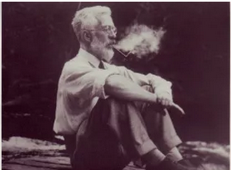
Causes of mortality in experiments and humans
To consult the statistician after an experiment is finished is often merely to ask him to conduct a post mortem examination. He can perhaps say what the experiment died of. -- Ronald Fisher (1938)
https://www.ucl.ac.uk/life-sciences/ronald-aylmer-fisher-1890-1962

Slide 2
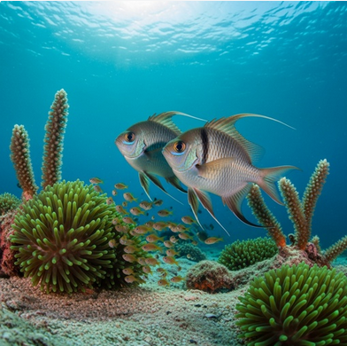
You want to compare behavior of animals before and after experimental intervention; specifically, you will observe the territorial behavior of breeding fish before and after removal of their brood.
You wonder whether the disturbance associated with catching the brood might affect the fish’ behavior, and consider to also observe a control group, in which you capture the brood but then immediately release it back to their parents’ territory.
However, observing the fish takes time. Your field work budget allows you to observe no more than 40 pairs. You are worried that your sample size will not provide enough power to detect an existing difference.
How should you best allocate your limited time resources:
30 pairs with brood permanently removed, 10 pairs with brood returned
20 pairs with brood permanently removed, 20 pairs with brood returned
All 40 pairs with brood permanently removed
https://www.shutterstock.com

Slide 3
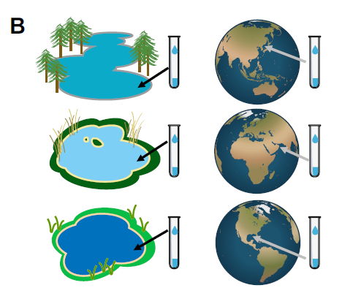
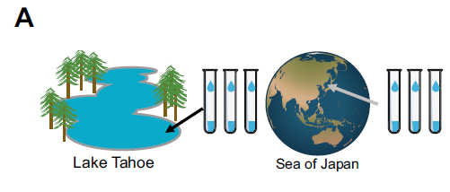
You want to find out whether carbon use efficiency differs between freshwater and marine microbial communities. What exactly do the following two designs test:
Wagner and Kleiner 2025; https://www.nature.com/articles/s41467-025-62616-x

Slide 4
You want to compare fungal colonization in the roots of two plant species. Soil quality varies across the experimental field. Which setup is most likely to detect any existing differences between the plant species?
Wagner and Kleiner 2025; https://www.nature.com/articles/s41467-025-62616-x

Slide 5
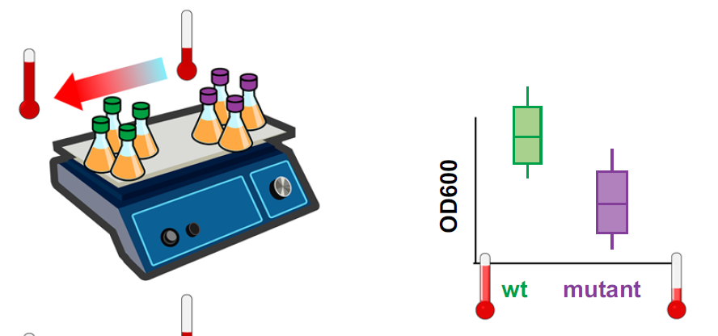
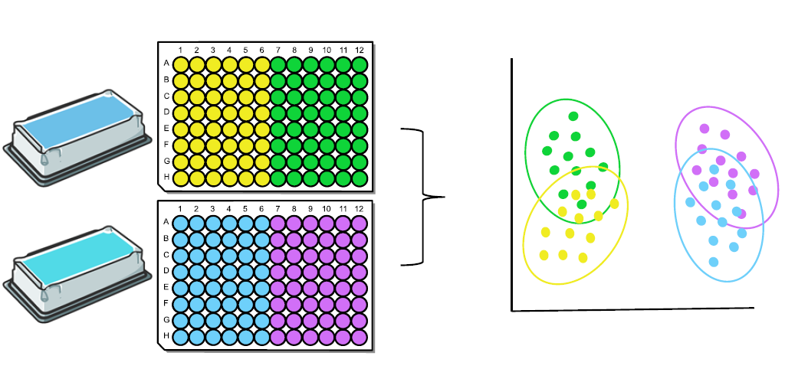

A manuscript reports significant growth differences between two bacterial strains (Fig. A), and greater similarity of gene expression responses to temperature treatments within than between strains (Fig. B). Do you agree?
A
B
Wagner and Kleiner 2025; https://www.nature.com/articles/s41467-025-62616-x

Slide 6
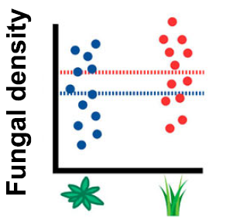
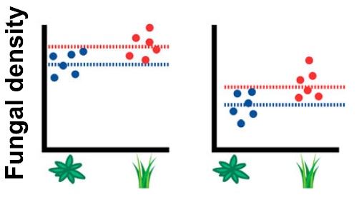
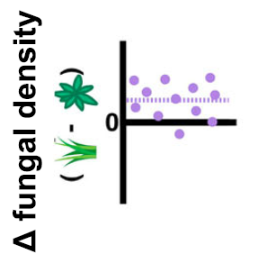
You want to compare fungal colonization in the roots of two plant species. Soil quality varies across the experimental field. Which setup provides the highest power to detect any existing differences between the plant species?

Slide 7
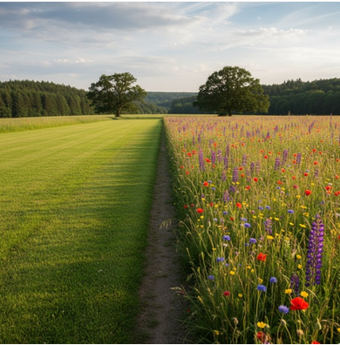
You want to compare soil characteristics in response to mowing regimes, and plan to examine multiple plots per treatment.
What are the problems with the following design?
https://www.shutterstock.com

